Slide 1
Datamart analysis tool
Automate Datamart design analysis
9 April 2015
Notes:
To remove the placeholders reserved for customer and product logos, click on them and press [Delete].

Slide 2
Contents
Introduction
Architecture
Demo
Summary
Notes:
The level styles are automatic : press [Tab] or [Shift] [Tab] to increase or decrease indent.
Manually apply red color on the current title and move the rectangle on it.

Slide 3
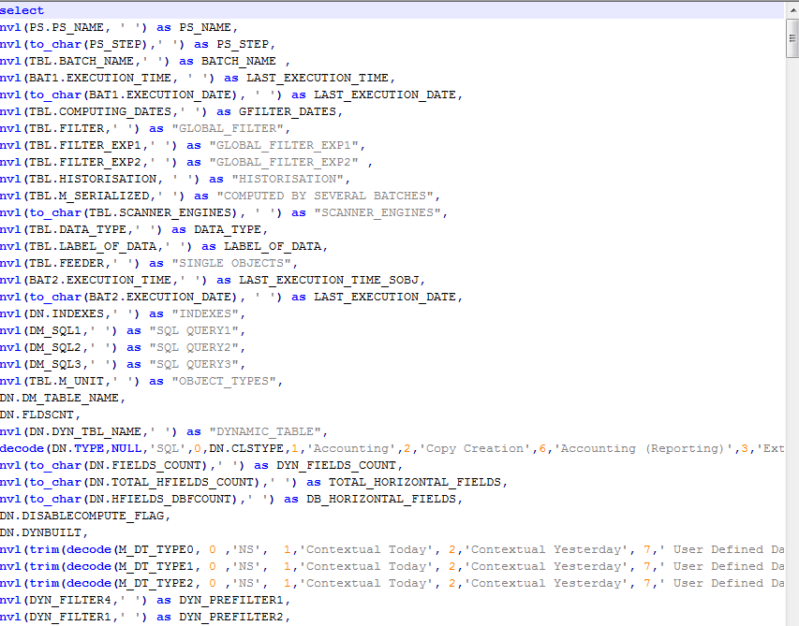

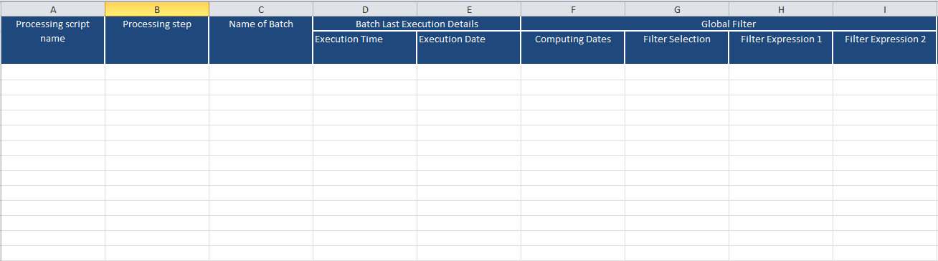
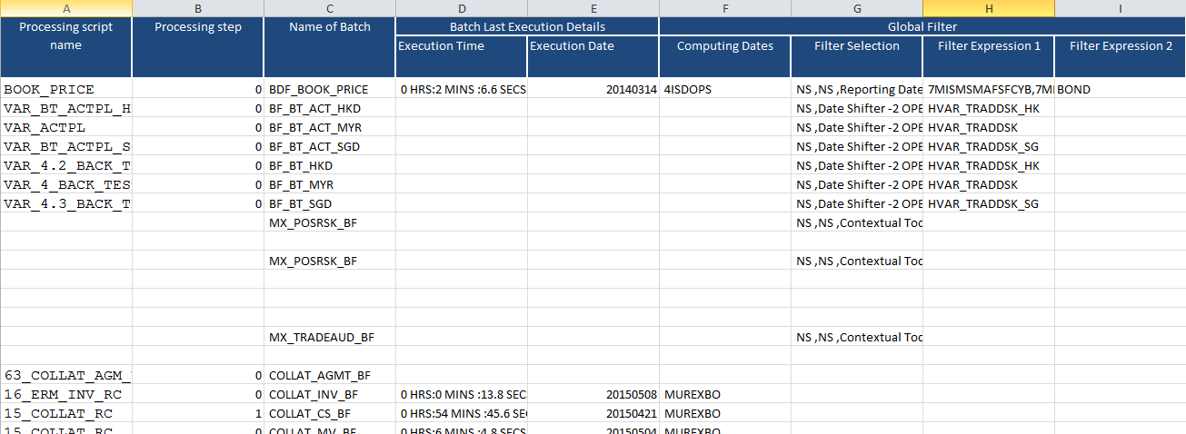
Introduction
Dm analysis tool
“Approach for analysis of Datamart objects” by Anand -- 2014
The approach consists of:
A template
Extract Data using SQL
Fill in the template
Manual Analysis
The analysis focuses on:
Dynamic tables
Feeders
Extractions
Execution details

Slide 4
Introduction
Dm analysis tool
Feedbacks
30+ columns to analyze
Potentially 1000+ rows
Analysis is time consuming
Manual analysis, hence not accurate

Slide 5

What can we do?
Dm analysis tool

Slide 6
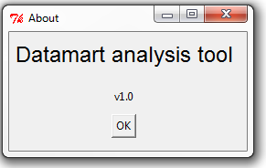
Datamart analysis tool v1.0
Dm analysis tool
Objectives
Automate the analysis on build quality
Automate the analysis on performance

Slide 7


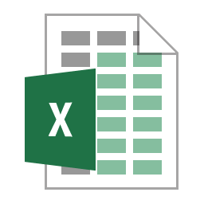
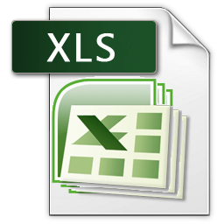



Architecture
Dm analysis tool
Config files
Input files
SQL files
MX DB
Notes:
Different blocks use different colors,
Use animation
Increase Font size to make the block visible.
Don’t need to have file names now.
Can have one slide per block to give more details.
Process block can use an image.

Slide 8
Architecture
Dm analysis tool
dbsource.mxres
paramters.txt
Process
Dynamic_table_
analysis
Property files
Datamart_analysis
Feeder_analysis
dm_defintion.xls
Performance_analysis
ps_execution_time
Computer_sensitivity
Output files
Source.xls
Query_dm_config.sql
Simulation_context
Query_dm_def.sql
Query_ps_time.sql
SQL files
Input files
Query_sentitivity.sql
Query_simulation.sql
Notes:
Different blocks use different colors,
Use animation
Increase Font size to make the block visible.
Don’t need to have file names now.
Can have one slide per block to give more details.
Process block can use an image.

Slide 9
Installation
Dm analysis tool
Requirement
Windows OS
Installation
Copy T:\Dept\Integration\Reporting\Tools\DM_Analysis to your local drive
Execution
Run run.bat in the folder

Slide 10
Preparation
Dm analysis tool
Before using the tool
If we have the access to the database, prepare the dbsource.rep file
If not, send the SQLs to users, ask users to run them and send the results back.
Place the files in \DM_Analysis\Input folder
Make sure the file names are exactly as follows
computer_sensitivity_check.csv (query_sensitivity_flag.sql)
dm_definition.csv (query_dm_config.sql)
ps_execution_time.csv (query_processing_script_time.sql)
simulation_context.csv (query_simulation_context.sql)
source.csv (query_dm_definition.sql)

Slide 11
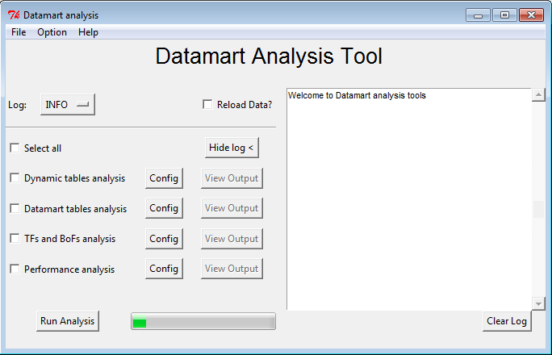
GUI - Main screen
Dm analysis tool
Notes:
Take a nice screenshot.
Try to combine 9 to 12 with animation
Show the real tool.

Slide 12
DEMO
Dm analysis tool
Dynamic tables analysis
Datamart tables analysis
TFs and BoFs analysis
Performance analysis
Notes:
Take a nice screenshot.
Try to combine 9 to 12 with animation
Show the real tool.

Slide 13
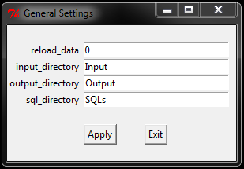
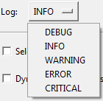
GUI
Dm analysis tool
Tool bar
Exit
General settings
About
Log Setting

Slide 14
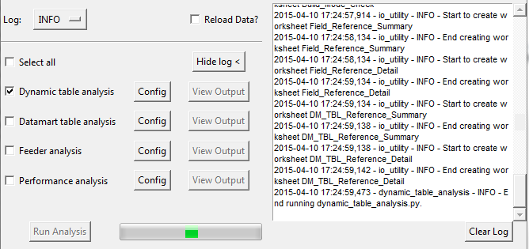
GUI
Dm analysis tool
Display Logs on main screen

Slide 15
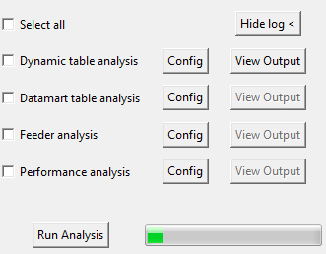
GUI
Dm analysis tool
Reload Data?
If we tick “Reload Data?”, the tool will try to retrieve data automatically from database
After successfully retrieved data, the tool will refresh all csv files in input folder.
It may take some time to reload all data depending on the size of the datamart size.
Run analysis
To run an analysis, simply tick it and click “Run analysis”. If you want to run all at once, tick “select all”

Slide 16
Sample : Hong Leong DM analysis
Dm analysis tool
Dynamic tables analysis
Number of Dynamic table fields that exceeds 200
It indicates that these 2 tables contains too many fields. If they are used in production, we’d suggest them to validate if all fields are necessary. If so, they shall split them into different dynamic tables.
Number of Dynamic table horizontal fields that exceeds 11
Number of Dynamic table fields that exceeds 200
Dynamic table name | Category | Dynamic table type | Field count
HL_FXOExpiry | User | DYN_TRNRP_PL | 639
HL_MM_SEC_Risk2 | User | DYN_TRNRP_PL | 374
Number of Dynamic table horizontal fields that exceeds 11
Dynamic table name | Category | Dynamic table type | Horizontal Field count
Bond_P&L(CONV&MI) | User Additional | DYN_TRNRP_PL | 20
ERM_COLLAT_MV | User Additional | DYN_TRNRP_MV | 14
MLC_TRNRP_MV | User Additional | DYN_TRNRP_MV | 53
HLMY_BOND_FI | User | DYN_TRNRP_PL | 32
HLMY_BOND_FI_2 | User | DYN_TRNRP_PL | 46
HLMY_BOND_ALM | User | DYN_TRNRP_PL | 14
HLMY_BOND_CONFO | User | DYN_TRNRP_PL | 14
HLMY_BOPESS | User | Accounting | 68
HLMY_CallDeposit | User | DYN_TRNRP_PL | 36
HL_TRNRP_PL_FEC2 | User | DYN_TRNRP_PL | 13
Notes:
Show the excel files from Hong Leong. By looking at these, any thing we shall worry about? Make it interactive!

Slide 17
Sample : Hong Leong DM analysis
Dm analysis tool
Dynamic table analysis
Number of Dynamic table horizontal fields that access database which exceeds 1
Any rows here means that the dynamic will look up fields in db which we don’t want. We can suggest them to use a SQL based table and join with the original DM table.
Dynamic tables sensitivity flag can be disabled
The dynamic table listed here can disable the sensitivity flag as they did not select any S_* or Sens_* fields in table fields.
Dynamic table name | Category | Dynamic table type | Direct DB access Parser functions (*TBLFIELD, *TABLE) used times
ERM_COLLAT_MV | User Additional | DYN_TRNRP_MV | 3
DCI_PACKAGE | User | DYN_TRNRP_PL | 2
MLC_TRNRP_MV | User Additional | DYN_TRNRP_MV | 18
Dynamic table name | Category
G_PL02.3 /RPPL | Murex
G_PLAA.2 /TRNRP_CS | Murex
G_FX.4 /TRNRP_DT | Murex
DYN_HDG_TRD_DETAILS | Murex
DYN_TPSI | Murex
G_OPDL.1 /TRNRP_PL | Murex
G_AUTR.3 /RPMK | Murex

Slide 18
Sample : Hong Leong DM analysis
Dm analysis tool
Dynamic table analysis
Dynamic table with wrong build on mode
Nothing appear here.
Summary of dynamic table fields reference
This sheet provides more insights of dynamic table definition. Users can use to revise their design, why same fields are referenced so many times.
Dynamic table name | Category | Simulation name | Build on mode
Dynamic table field | Dynamic table type | # of reference
NB | DYN_TRNRP_PL | 173
TP_CNTRP | DYN_TRNRP_PL | 147
TP_DTEEXP | DYN_TRNRP_PL | 143
TP_DTETRN | DYN_TRNRP_PL | 140
TP_PFOLIO | DYN_TRNRP_PL | 133
TRN_TYPE | DYN_TRNRP_PL | 133
TP_ENTITY | DYN_TRNRP_PL | 130
TRN_GRP | DYN_TRNRP_PL | 129
TRN_FMLY | DYN_TRNRP_PL | 127
TP_NOMINAL | DYN_TRNRP_PL | 118
TP_BUY | DYN_TRNRP_PL | 117
TP_NOMCUR | DYN_TRNRP_PL | 115
TP_PRICE | DYN_TRNRP_PL | 110
TP_TYPO | DYN_TRNRP_PL | 109
TP_STATUS2 | DYN_TRNRP_PL | 105

Slide 19
Sample : Hong Leong DM analysis
Dm analysis tool
Dynamic table analysis
Details of dynamic table fields reference
This sheet needs to be combined with the previous sheet for analysis of dynamic table reference. If we found a field with a lot of reference, we can drill down it in this sheet.
Dynamic table field | Dynamic table category | Dynamic table | Dynamic table type | Datamart table
TP_CNTRP | Murex | DYN_CS_C | DYN_TRNRP_CS | CS_C.REP
TP_CNTRP | Murex | DYN_MV_C012 | DYN_TRNRP_MV | MV_C012.REP
TP_CNTRP | Murex | DYN_CS | DYN_TRNRP_CS | CS.REP
TP_CNTRP | Murex | DYN_PL_C012 | DYN_TRNRP_PL | PL_C012.REP
TP_CNTRP | Murex | DYN_CASH_FLOW | DYN_TRNRP_CS | CASH_FLOW.REP
TP_CNTRP | Murex | DYN_TP_ALL | DYN_TRNRP_PL | TP_ALL.REP
TP_CNTRP | Murex | DYN_CASH_ARCH | DYN_TRNRP_CS | CASH_ARCH.REP
TP_CNTRP | Murex | DYN_EVT_DETAILS | DYN_TRNRP_CD | EVT_DETAILS.REP
TP_CNTRP | Murex | DYN_PL_DETAILED | DYN_TRNRP_PL | PL_DETAILED.REP
TP_CNTRP | Murex | DYN_REC_CS | DYN_TRNRP_CS | REC_CS.REP
TP_CNTRP | User | HLMY_ECOS | DYN_TRNRP_PL | HLMY_ECOS.REP
TP_CNTRP | User | HLMY_CIB_FEC | DYN_TRNRP_PL | HLMY_FEC_CIB.REP
TP_CNTRP | User | HLMY_CIB | DYN_TRNRP_PL | HLMY_CIB.REP
TP_CNTRP | User | CSA | DYN_TRNRP_PL | CSA.REP
TP_CNTRP | User | HL_TRNRP_PL_FEC2 | DYN_TRNRP_PL | HLMY_DAILYFECREP.REP
TP_CNTRP | User | HLMY_DCI_CRM | DYN_TRNRP_PL | HLMY_DCI_CRM.REP

Slide 20
Sample : Hong Leong DM analysis
Dm analysis tool
Dynamic table analysis
Summary of dynamic table reference
This dynamic tables are referenced more than once. Why?
Details of dynamic table reference
This sheet shows which datamart tables use those dynamic tables. It will be easier for users to do further investigation.
Dynamic table name | Category | Dynamic table type | # of Datamart table referenced
MLC_TRNRP_FX | User Additional | Copy Creation | 2
HL_TRNRP_PL_FEC2 | User | DYN_TRNRP_PL | 3
MLC_CS_LIVE | User Additional | DYN_TRNRP_CS | 2
ERM_BT_MYR_2 | User | PL VAR | 3
DYN_TP | User | DYN_TRNRP_PL | 2
ERM_MKT_IRBASIS_AH | User Additional | Simulation | 2
Dynamic table name | Category | Dynamic table type | Datamart Table Name
MLC_TRNRP_FX | User Additional | Copy Creation | MLC_FX.DBF
MLC_TRNRP_FX | User Additional | Copy Creation | ERM_FX.REP

Slide 21
Sample : Hong Leong DM analysis
Dm analysis tool
Datamart table analysis
Datamart table fields exceeds 199
Tables with 200 fields! They shall find way to reduce the size of the tables.
Datamart table has less fields than dynamic table fields
Can we uncheck those fields found in dynamic tables but not used in datamart tables?
Datamart table name | Field count
PL_012.REP | 248
HLSG_BOND.REP | 224
HL_PL_012.REP | 254
HLSG_BOND_NEW.REP | 311
PL_C012.REP | 202
ERM_MV.REP | 217
Datamart table name | Field count | Dynamic table name | Category | Dynamic table field
HLMY_FEC_CPP.REP | 59 | HLMY_FEC_CPP | User | 71
MKBK_2.REP | 11 | DYN_MKBK_2 | Murex | 31
BT_ACT_MYR_MKTOP.REP | 12 | ERM_BT_ACT_MYR_MKTOP | User | 14
FIXING.REP | 25 | DYN_FIXING | Murex | 27
HLMY_BOPESS.REP | 67 | HLMY_BOPESS | User | 84
MLC_CS_DEAD2.DBF | 19 | MLC_CS_DEAD2 | User Additional | 38
HL_FIN_KLGINT.DBF | 44 | HL_FIN_KLGLINT_TBL | User | 66
HLMY_FEC_CRM.REP | 61 | HLMY_FEC_CRM | User | 63
HL_FIN_KLGINT.REP | 52 | HL_FIN_KLGLINT_TBL | User | 66
HLMY_BOND2.REP | 117 | HLMY_BOND_FI_2 | User | 162
CASH_FLOW.REP | 34 | DYN_CASH_FLOW | Murex | 57

Slide 22
Sample : Hong Leong DM analysis
Dm analysis tool
Datamart table analysis
Datamart tables with no index
All datamart tables shall have at least 1 index.
Datamart table name | Index count
HEDGE_MSRMNT.REP | 0
IRD_BASIS_RISK.REP | 0
BT_ACT_MYR_MKTOP.REP | 0
C_CNT_EVT_UDF.REP | 0
ACC_JOURNAL.REP | 0
PARTIES.REP | 0
CASH_ARCH.REP | 0

Slide 23
Sample : Hong Leong DM analysis
Dm analysis tool
Feeder analysis
Summary of referenced feeders.
DM Tables in Feeder
These 2 sheets also shall be analyzed together. It found that there are some feeders contain more than 1 table. Mx recommands that feeder shall only contain 1 table for flexibility. Users may want to split these tables into different feeder.
Name of feeders | # of underlying dm tables
HL_HLM_DAILYPL | 3
FD_HL_BSDTLS_TR | 2
FD_TMP_FOM | 2
FD_IRS_MAIN | 2
Feeder | DM Table | Last Execution Date
HL_HLM_DAILYPL | DAILYPL.REP
HL_HLM_DAILYPL | DAILYPL_YTD.REP
HL_HLM_DAILYPL | HL_TRNRP_MV.REP

Slide 24
Sample : Hong Leong DM analysis
Dm analysis tool
Feeder analysis
Summary of referenced DM tables.
DM table referenced in more than 2 single feeders
These 2 sheets shall be combined for analysis. It indicates those datamart tables are populated by different feeders. In this case, it may cause duplication of data. We shall check if we can only keep 1 feeder for 1 table.
Name of Datamart table | # of Referenced feeders
HL_TRNRP_NOTYPO.REP | 2
MKBK_2.REP | 2
HL_FIN_KLGINT.REP | 2
TPBD.REP | 5
HL_PL_GLOBAL.REP | 2
DM Table Name | Feeder name | Description | Last Execution Date
HL_FIN_KLGINT.REP | HL_GLINT_FD | Data Feeder for KL GL Interface
HL_FIN_KLGINT.REP | HL_FIN_GLINT_FD | Feeder for GLINT | 20100617

Slide 25
Sample : Hong Leong DM analysis
Dm analysis tool
Feeder analysis
Summary of referenced feeders.
Feeder referenced in more than 2 batches
These 2 sheets also shall be analyzed together. The question here is why we have same feeder in different batch of feeder? Shall we remove the same feeder from different batch of feeders?
Name of feeders | # of Referenced Batch feeders
FD_XNIDI_CRM | 2
FD_ACAC | 5
FD_HL_MLCRISK3 | 2
FD_TRNRP_PL_SMP | 3
FD_TRN_CPDF | 3
Feeder | Batch of feeder | Description | Global filter | Label of data | Last Execution Date
FD_XNIDI_CRM | BDF_NIDIBB |  |  | NIDI_CRM | 20140315
FD_XNIDI_CRM | BDF_NIDI_CRM | CRM -- ALL NIDI & XNIDI |  | NIDI_CRM1

Slide 26
Sample : Hong Leong DM analysis
Dm analysis tool
Feeder analysis
Summary of referenced batch of feeder.
Batch of Feeder referenced in more than 2 processing scripts
These 2 sheets also shall be analyzed together. We see same batch of feeders are in different processing scripts. We can use the second sheets to check if they are executed recently. If yes, we can challenge why?
Name of batch feeders | # of Referenced Processing scripts
BDF_HL_OPT_ORG | 2
BDF_ALM_BOND | 3
BDF_STPSIA_CRM | 4
BDF_LOANDEPOSIT | 2
BDF_FXSPOTFWD | 3
BDF_DCI_CRM | 3
BDF_BARSMP_OPT | 3
Batch of Feeder | Entity | Processing Script | Last execution date
BDF_STPSIA_CRM |  | CRM_STPSIA
BDF_STPSIA_CRM |  | CTU_REPORTS
BDF_STPSIA_CRM |  | AVERAGE_BALANCE
BDF_STPSIA_CRM |  | CKM_STPSIA

Slide 27
Sample : Hong Leong DM analysis
Dm analysis tool
Feeder analysis
Batch of feeders scanner engine usage
For all the batch of feeders listed with 0 process number, we shall recommend clients to enable them unless the feeder only populates very few data.
Number of feeders in a batch of feeders
Mx recommand 1 feeder in 1 batch of feeders only. Batch of feeders listed here shall be adapted to contain 1 feeder only.
Batch of feeder | Dynamic table type | Template | Process number | Batch type | Batch size | Retries | Retries batch size
BDF_SG_BOND_NEW | DYN_TRNRP_PL |  | 0 |  | 0 | 0 | 0
C_BE_ALM_IRS | DYN_TRNRP_PL |  | 0 |  | 0 | 0 | 0
BDF_SR2_FIN | DYN_TRNRP_PL |  | 0 |  | 0 | 0 | 0
C_BE_DLY_DEALS | PL VAR |  | 0 |  | 0 | 0 | 0
C_BE_OUT_SGD | DYN_TRNRP_PL |  | 0 |  | 0 | 0 | 0
BDF_SR2_FXPDEAD | DYN_TRNRP_PL |  | 0 |  | 0 | 0 | 0
BDF_HL_SIA_DAY | DYN_TRNRP_PL |  | 0 |  | 0 | 0 | 0
Batch of feeders | Number of Feeders (BoF size)
MX_PL_SECFIN_BF | 1
BF_MRA_MYR_VAR | 1
ERM_CS_BF | 1
MLC_CNS | 2
MX_FXC_DETPL_BF | 1
ERM_MKT_BF | 4
MX_ALL_ST_BF | 3

Slide 28
Sample : Hong Leong DM analysis
Dm analysis tool
Feeder analysis
Dynamic Tables with Multiple Filters (Table Level and Batch of Feeder Level)
This sheet shows batch of feeders with global filter and underlying dynamic table also contains default filter. They may potentially conflict each other. Client must be very careful about them.
Batch of feeders have possible wrong dataset settings marked as inconsistent in last column
Here list all inconsistent setting for label of data in batch of feeders. With such inconsistent setting, ref_data key will not be reliable. Clients need to correct them.
EOD_DATA_D | C_BE_DCI_MID_RT | ONE DATA SET | DATA PUBLISHED | N | OK
EOD_DATA_D | C_MKT_SENSI_BF | ONE DATA SET PER DAY | DATA PUBLISHED | Y | Inconsistent
EOD_DATA_D | C_BE_HWRK_FTPMR | ONE DATA SET | DATA PUBLISHED | N | OK
EOD_DATA_D | C_ACJS_BF | ONE DATA SET PER DAY | DATA PUBLISHED | Y | Inconsistent
EOD_DATA_D | C_PL_BF | ONE DATA SET PER DAY | DATA PUBLISHED | Y | Inconsistent
EOD_DATA_D | C_MD_HISTRT_BF | ONE DATA SET PER DAY | DATA PUBLISHED | Y | Inconsistent
EOD_DATA_D | C_DELTA_HEDG_BF | ONE DATA SET PER DAY | DATA PUBLISHED | Y | Inconsistent
EOD_DATA_D | C_ACJD_BF | ONE DATA SET PER DAY | DATA PUBLISHED | Y | Inconsistent
EOD_DATA_D | C_BE_HLHKMI_GL | ONE DATA SET | DATA PUBLISHED | N | OK
EOD_DATA_D | C_EVT_HIS_BF | ONE DATA SET PER DAY | DATA PUBLISHED | Y | Inconsistent

Slide 29
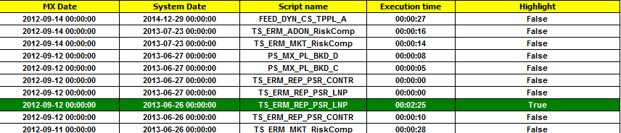
Sample : Hong Leong DM analysis
Dm analysis tool
Performance analysis
DM processing scripts execution time
Script with execution longer than what we set in config will be highlighted. We can further analyze this script in next sheet.

Slide 30
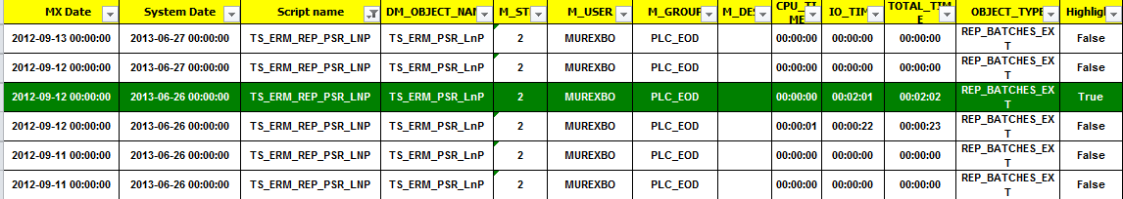
Sample : Hong Leong DM analysis
Dm analysis tool
Performance analysis
Breakdown of DM processing scripts execution time by objects
This sheet shows the detailed breakdown of the script’s execution time. We can see the there is one batch of feeder in processing script “TS_ERM_REP_PSR_LNP took extra long time. In addition, we know that most of its execution time is spent on IO, then we can further investigate how to reduce its execution time.

Slide 31
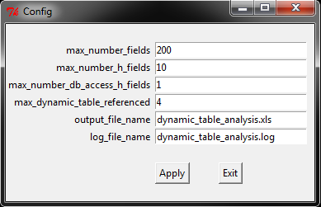
Dynamic tables Analysis
Dm analysis tool
Available analysis for Dynamic tables analysis
Number of Dynamic table fields that exceeds @max_number_fields
Number of Dynamic table horizontal fields that exceeds @max_number_h_fields
Number of Dynamic table horizontal fields that access database which exceeds @max_number_db_access_h_fields
Dynamic tables sensitivity flag that can be disabled but not
Dynamic table with wrong build on mode
Summary of dynamic table field reference
Details of dynamic table field reference
Dynamic table reference status summary
Dynamic table reference status details
Notes:
Animation for the each points. Wipe left to right. Show one by one

Slide 32
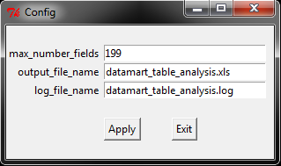
Datamart tables analysis
Dm analysis tool
Available analysis for datamart tables
Datamart table fields exceeds @max_number_fields
Datamart table has less fields than dynamic table fields
Datamart tables with no index

Slide 33
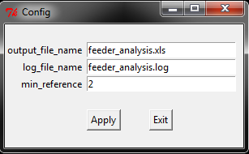
TFs and BoFs analysis
Dm analysis tool
Available analysis for feeders
Summary of referenced DM tables.
DM tables referenced in more than @min_reference single feeders
Summary of referenced feeders.
DM Tables in Feeder
Summary of referenced feeders.
Feeder referenced in more than @min_reference batches
Summary of referenced batch of feeder.
Batch of Feeder referenced in more than @min_reference processing scripts
Batch of feeders scanner engine usage
Number of feeders in a batch of feeders
Dynamic Tables with Multiple Filters (Table Level and Batch of Feeder Level)
Batch of feeders have possible wrong dataset settings marked as inconsistent in last column

Slide 34
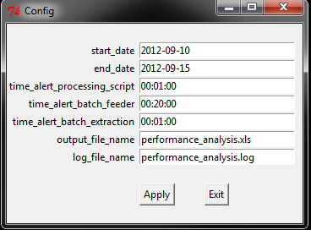
Performance analysis
Dm analysis tool
Available analysis for performance
Summary of DM processing scripts execution time. The entries will be highlighted, if the execution time is longer than @time_alert_processing_script.
Breakdown of DM processing scripts execution time by objects. The entries will be highlighted, if the execution time is longer than @time_alert_batch_feeder.
The execution date for the processing scripts is from @start_date to @end_date.

Slide 35
THANK YOU

